Slide 1
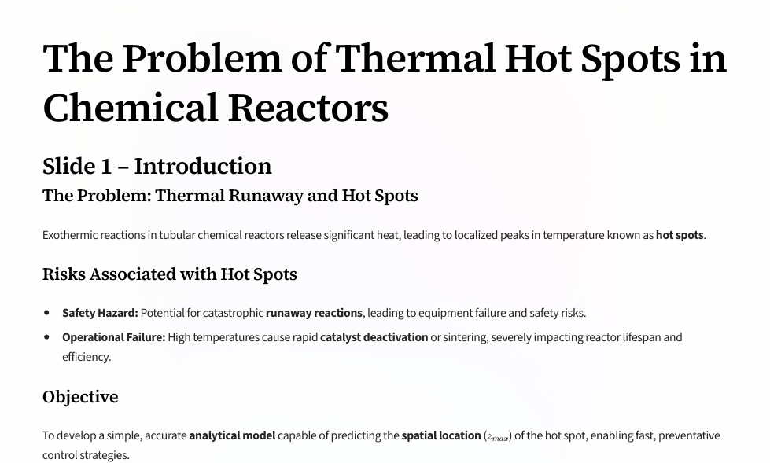
Notes:
Start by framing the risk: in packed-bed tubular reactors heat from exothermic chemistry can produce local peaks in temperature (hot spots). These are critical because they can cause thermal runaway or permanently damage catalysts. Numerical simulations and dense sensor arrays are common solutions but can be slow or costly. Our approach: make controlled, realistic assumptions (1-D axial model, plug flow, negligible radial gradients) and derive an explicit relation for the hot-spot location so we can design cooling or place sensors where they matter most.

Slide 2
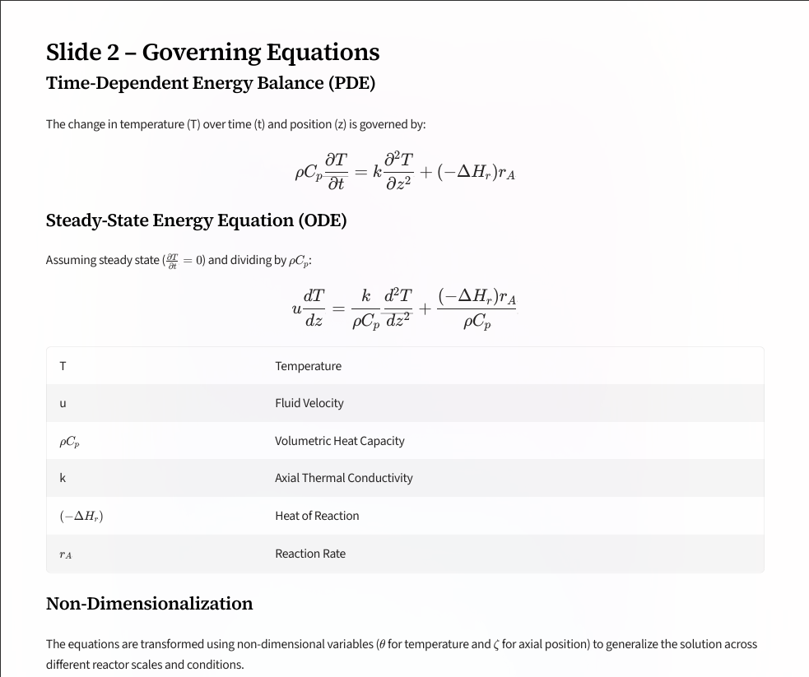

Slide 3
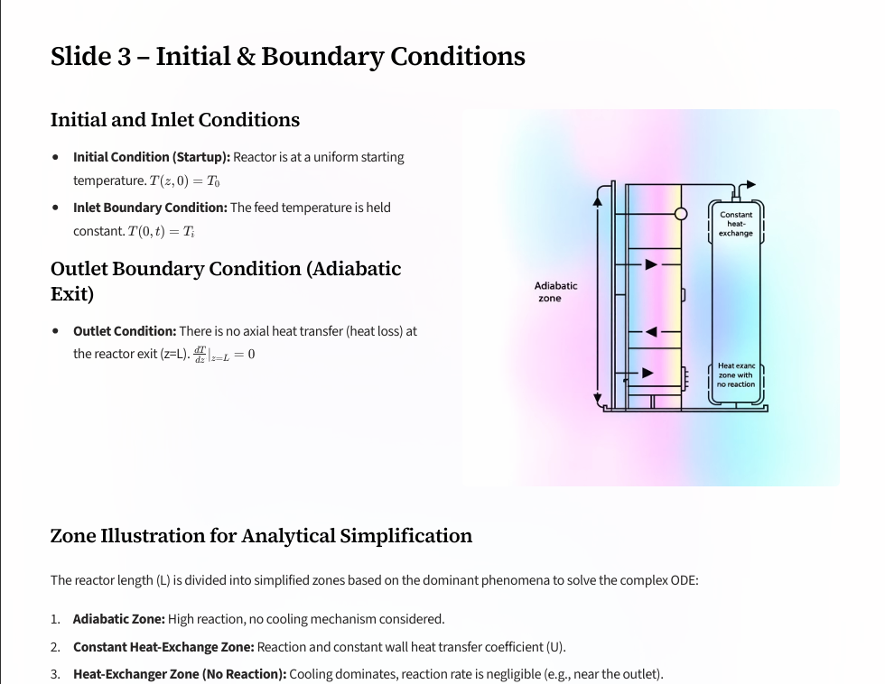

Slide 4
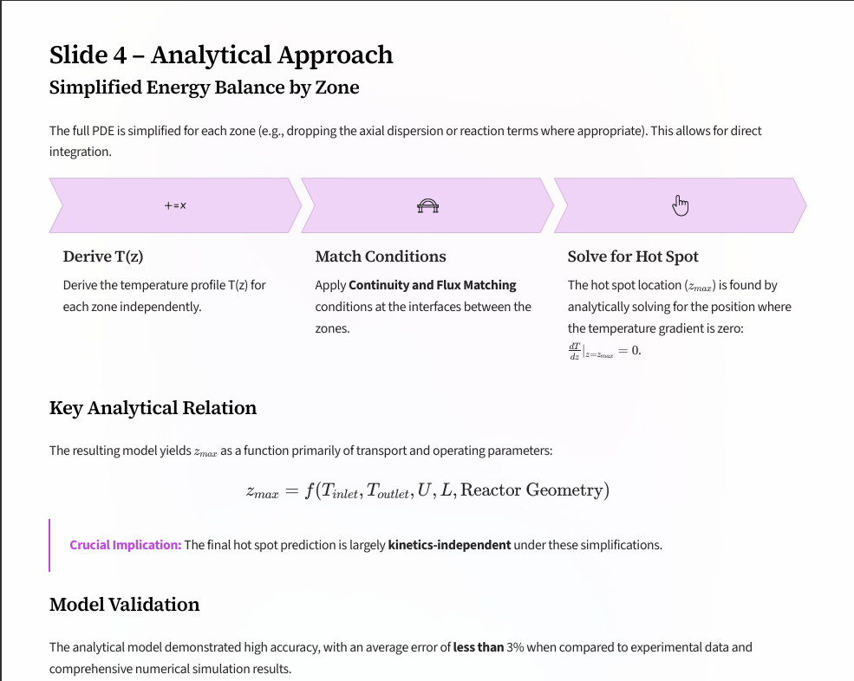

Slide 5
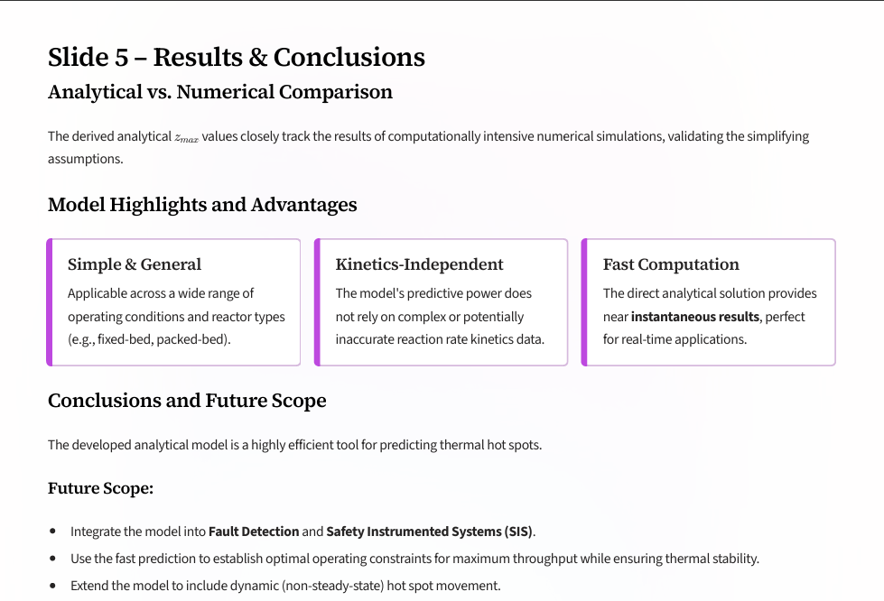

Slide 6


